Slide 1
E-commerce Product Delivery Prediction
Prepared by: Vishal Kulkarni Date: 31-01-2025

Slide 2
Agenda
Introduction
Data Description
Methodology
Key Insights
Model Performance
Conclusion
Recommendations
Future Work
Questions

Slide 3
Introduction
The company, specializing in electronic products, seeks insights from its customer database to optimize delivery performance and enhance customer satisfaction.
The goal is to predict whether products will reach customers on time using machine learning models.
By analyzing factors affecting delivery timeliness, the company aims to refine its logistics strategy and reduce delivery delays.

Slide 4
Data Description
The dataset comprises 10,999 observations across 12 variables, including:
Warehouse block
Mode of shipment
Customer care calls
Product cost
Prior purchases
Product importance
Discount offered
Weight of the product
Delivery performance (target variable: on-time delivery or delay)

Slide 5
Methodology
Data Preprocessing
Cleaned data (handled missing values, duplicates, and irrelevant columns).
Converted categorical variables into numerical representations using label encoding.
Normalized numerical features where necessary.
Exploratory Data Analysis (EDA)
Visualized distributions and relationships between features.
Identified correlations between delivery timeliness and independent variables.
Feature Engineering
Applied encoding techniques to categorical variables.
Analyzed feature importance using statistical methods and tree-based algorithms.
Model Building
Implemented multiple machine learning models including Decision Tree, Random Forest, Logistic Regression, and KNN.
Optimized hyperparameters for improved accuracy.
Model Evaluation
Assessed model performance using accuracy, confusion matrix, precision, recall, and F1-score.

Slide 6
Key Insights
Product weight and cost significantly impact delivery timeliness, with heavier and costlier products having higher chances of delay.
Warehouse F, likely near a seaport, handles most shipments, predominantly via shipping, contributing to longer delivery times.
Customer engagement (calls, prior purchases) and promotional discounts correlate with delivery performance.
Mode of shipment plays a crucial role in predicting delivery success, with flights being the fastest and road transport having the highest delay rate.

Slide 7
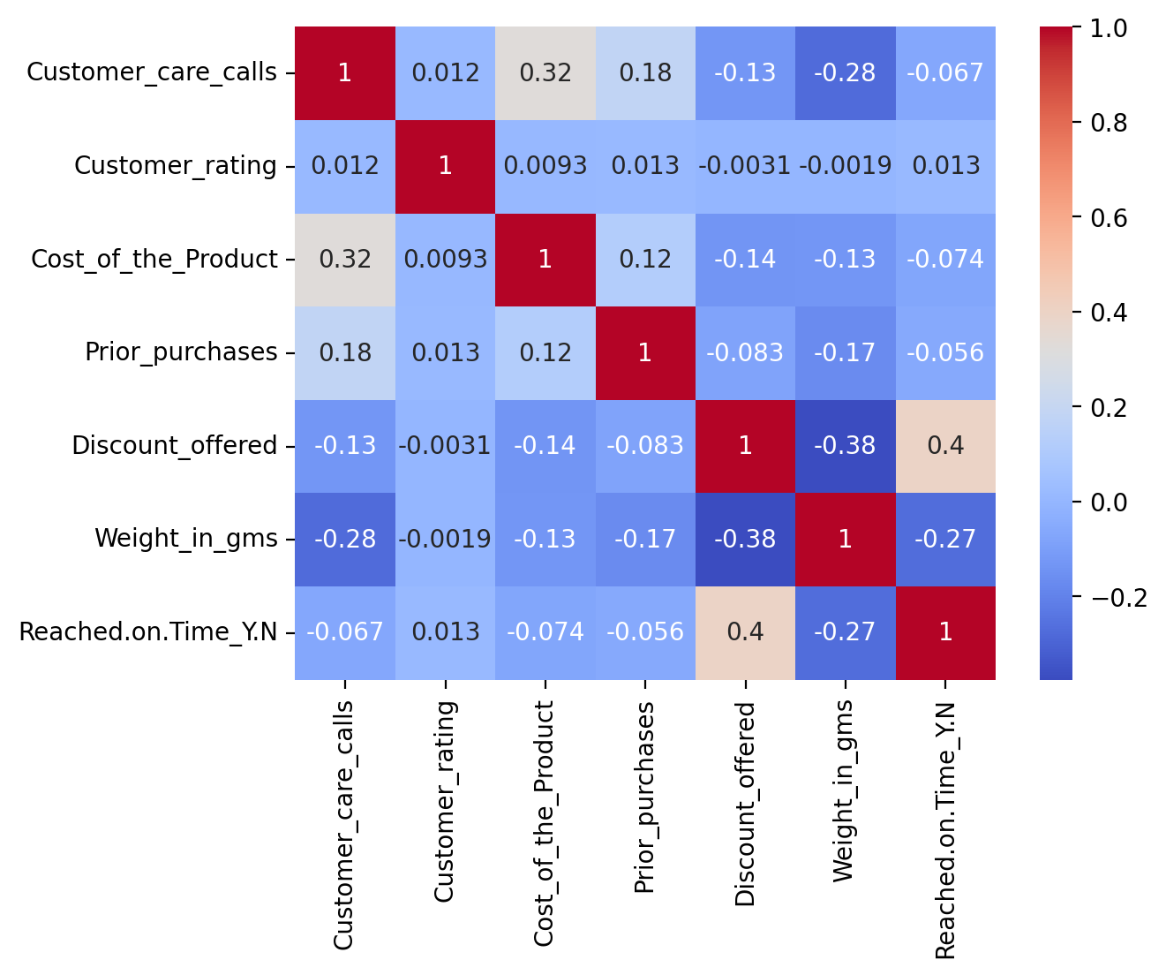
Correlation Heatmap Observations:
Positive Correlation:
Product cost ↔ Customer care calls (indicating customer concerns for high-value items).
Negative Correlation:
Discounts ↔ Delivery delays (higher discounts improve punctuality).

Slide 8
Machine Learning Models
Models Used:
Decision Tree Classifier:
Selected optimal parameters via grid search.
Best depth: 6, minimum samples split: 2.
Random Forest Classifier:
Explored ensemble learning for improved accuracy.
Selected optimal parameters via grid search.
Best depth: 8, minimum samples split: 2.
Logistic Regression:
Interpreted linear relationships between features.
K-Nearest Neighbors:
Examined proximity-based decision-making.
Train-Test Split:
Training accuracy varied from 63% to 78%.
Test accuracy ranged between 63% and 69%.

Slide 9
Model Performance
Decision Tree Classifier: Highest accuracy at 69%.
Random Forest & Logistic Regression: Comparable performance at 68% and 67%.
K-Nearest Neighbors : Lowest accuracy at 65%.
The Decision Tree model was chosen as the final model due to its interpretability, ability to handle non-linear relationships, and its superior performance in capturing key decision patterns in the dataset, achieving an accuracy score of 69%.

Slide 10
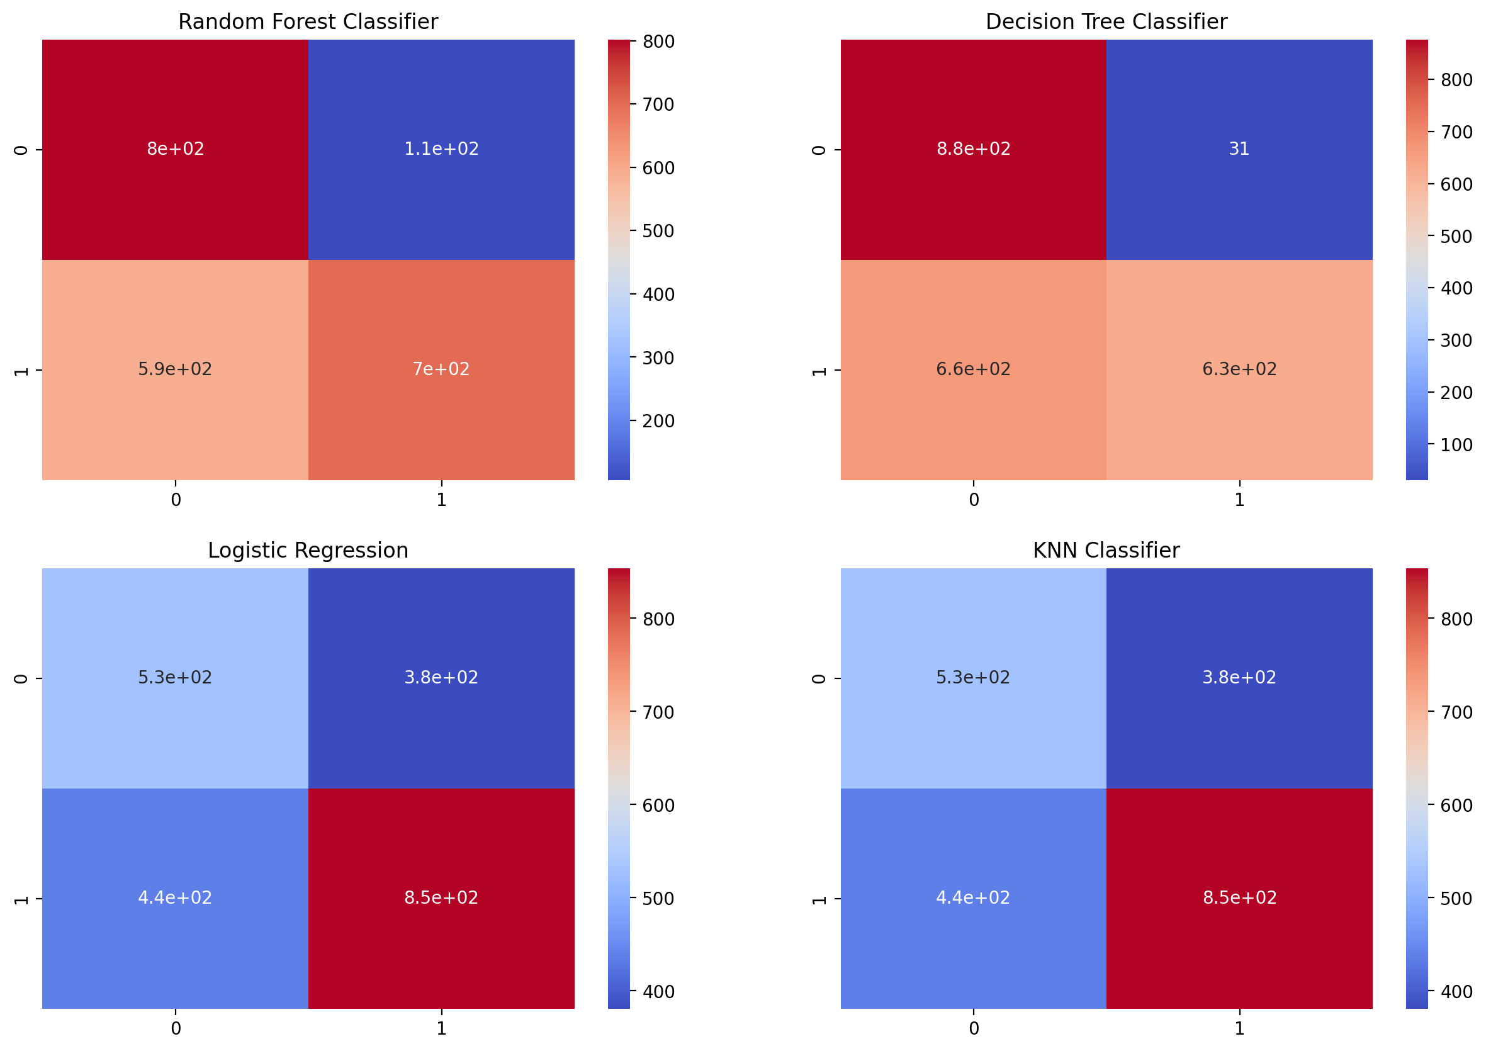
Model Evaluation

Slide 11
Key Findings
Insights from EDA and Modeling:
Product Factors:
Products between 2500-3500 grams delivered on time more often.
High-value products ($250+) experienced delays.
Warehouse Logistics:
Warehouse F processed a majority of on-time deliveries, likely due to saport proximity.
Customer Behavior:
Frequent customer care calls indicated delivery issues.
Repeat customers benefited from more reliable deliveries.
Discounts:
Offers >10% improved delivery punctuality.

Slide 12
Conclusion
The project successfully identified key factors affecting delivery performance.
A robust predictive model helps streamline logistics and improve operational efficiency.
The insights gained can help the company adjust its shipping methods and warehouse distribution strategies

Slide 13
Recommendations
Improve efficiency at Warehouse F by optimizing shipment schedules and diversifying transport modes.
Enhance logistic tracking for high-cost and high-weight items to reduce delays.
Offer predictive insights to customers on potential delivery delays based on real-time factors.
Optimize discounts strategically, as excessive discounts correlate with delayed shipments.

Slide 14
Questions ?

Slide 15
Thank You!

